Slide 1
Human Activity Recognition
Edwin Candinegara

Slide 2
Data Collection
13 persons – including myself (6 males, 7 females, 19-24 years old)
Collected Data Summary:
15 activities / person
TOTAL: 629 mins
Name | Duration | Name | Duration | Name | Duration
Edwin | 89 | Elmo | 45 | Orlin | 45
Shelina | 45 | Monica | 45 | Valerie | 45
Mellita | 45 | Inge | 45 | Nathania | 45
Nikolas | 45 | Andri | 45
Samuel | 45 | Arianto | 45

Slide 3
KFOLD 11 Persons Results

Slide 4
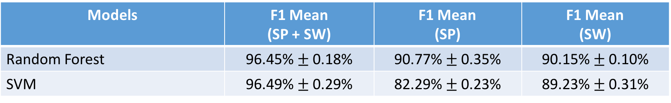
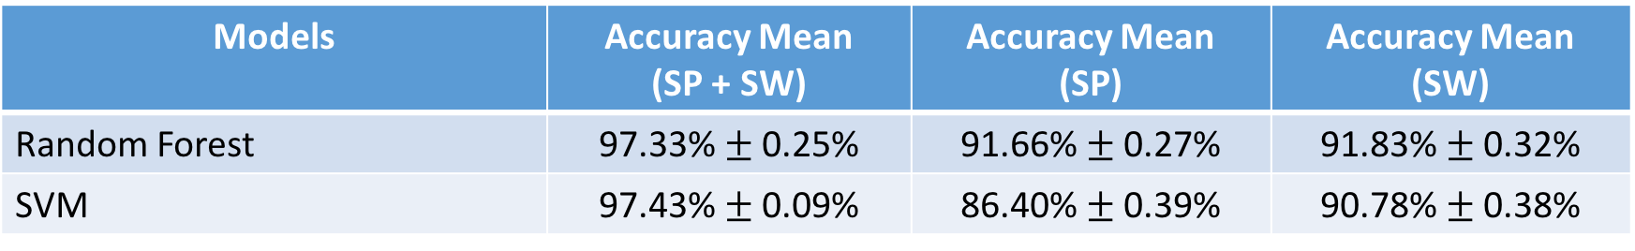
5-Fold CV on Combined Dataset (11 persons)
14 activities (WITHOUT EATING), Sampling @ 10 Hz, Window size = 2s
Comparison → 14 activities (WITHOUT EATING), 6 Persons results:
Models | F1 Mean (SP + SW) | F1 Mean (SP) | F1 Mean (SW)
Random Forest | 96.45% $±$ 0.18% | 90.77% $±$ 0.35% | 90.15% $±$ 0.10%
SVM | 96.49% $±$ 0.29% | 82.29% $±$ 0.23% | 89.23% $±$ 0.31%
Models | Accuracy Mean (SP + SW) | Accuracy Mean (SP) | Accuracy Mean (SW)
Random Forest | 97.33% $±$ 0.25% | 91.66% $±$ 0.27% | 91.83% $±$ 0.32%
SVM | 97.43% $±$ 0.09% | 86.40% $±$ 0.39% | 90.78% $±$ 0.38%

Slide 5

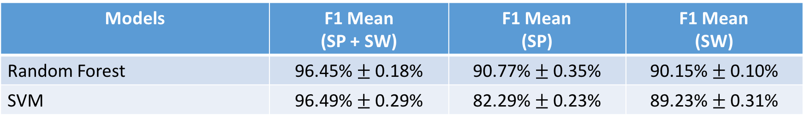
5-Fold CV (11 persons) – CORRELATION ACC_MAG
14 activities (WITHOUT EATING), Sampling @ 10 Hz, Window size = 2s
Comparison → 14 activities (WITHOUT EATING), 11 Persons results:
Models | F1 Mean (SP + SW) | F1 Mean (SP) | F1 Mean (SW)
Random Forest | 96.45% $±$ 0.22% | 90.45% $±$ 0.27% | 90.12% $±$ 0.33%
SVM | 96.32% $±$ 0.17% | 81.82% $±$ 0.47% | 89.03% $±$ 0.48%
Models | F1 Mean (SP + SW) | F1 Mean (SP) | F1 Mean (SW)
Random Forest | 96.45% $±$ 0.18% | 90.77% $±$ 0.35% | 90.15% $±$ 0.10%
SVM | 96.49% $±$ 0.29% | 82.29% $±$ 0.23% | 89.23% $±$ 0.31%

Slide 6
LOO 11 PERSONS (NEW)

Slide 7
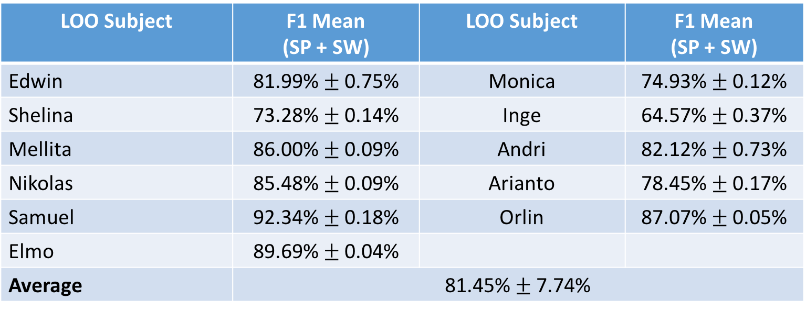
LOO (11 PERSONS)
14 Activities (without Eating)
RF→ Number of Estimators = 500, average of 3 runs / subject
LOO Subject | F1 Mean (SP + SW) | LOO Subject | F1 Mean (SP + SW)
Edwin | 81.99% $±$ 0.75% | Monica | 74.93% $±$ 0.12%
Shelina | 73.28% $±$ 0.14% | Inge | 64.57% $±$ 0.37%
Mellita | 86.00% $±$ 0.09% | Andri | 82.12% $±$ 0.73%
Nikolas | 85.48% $±$ 0.09% | Arianto | 78.45% $±$ 0.17%
Samuel | 92.34% $±$ 0.18% | Orlin | 87.07% $±$ 0.05%
Elmo | 89.69% $±$ 0.04%
Average | 81.45% $±$ 7.74%

Slide 8
LOO 11 PERSONS (CORR)

Slide 9
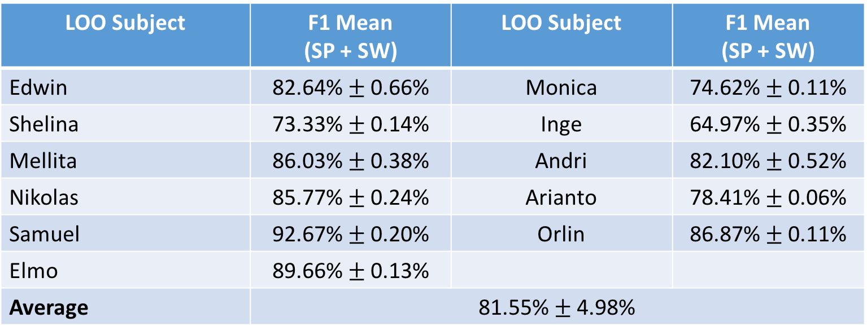
LOO (11 PERSONS)
14 Activities (without Eating)
RF→ Number of Estimators = 500
LOO Subject | F1 Mean (SP + SW) | LOO Subject | F1 Mean (SP + SW)
Edwin | 82.64% $±$ 0.66% | Monica | 74.62% $±$ 0.11%
Shelina | 73.33% $±$ 0.14% | Inge | 64.97% $±$ 0.35%
Mellita | 86.03% $±$ 0.38% | Andri | 82.10% $±$ 0.52%
Nikolas | 85.77% $±$ 0.24% | Arianto | 78.41% $±$ 0.06%
Samuel | 92.67% $±$ 0.20% | Orlin | 86.87% $±$ 0.11%
Elmo | 89.66% $±$ 0.13%
Average | 81.55% $±$ 4.98%

Slide 10
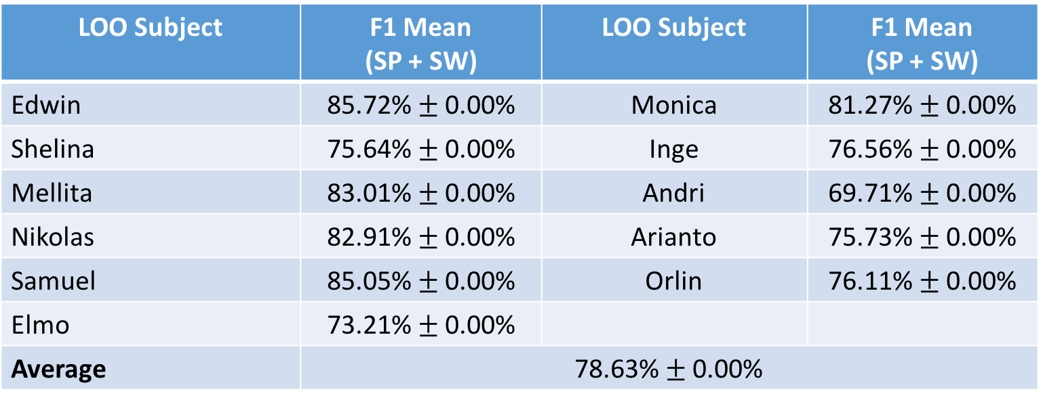
LOO (11 PERSONS)
14 Activities (without Eating)
SVM → C = 1, Gamma = 0.1
LOO Subject | F1 Mean (SP + SW) | LOO Subject | F1 Mean (SP + SW)
Edwin | 85.72% $±$ 0.00% | Monica | 81.27% $±$ 0.00%
Shelina | 75.64% $±$ 0.00% | Inge | 76.56% $±$ 0.00%
Mellita | 83.01% $±$ 0.00% | Andri | 69.71% $±$ 0.00%
Nikolas | 82.91% $±$ 0.00% | Arianto | 75.73% $±$ 0.00%
Samuel | 85.05% $±$ 0.00% | Orlin | 76.11% $±$ 0.00%
Elmo | 73.21% $±$ 0.00%
Average | 78.63% $±$ 0.00%

Slide 11
Questions
Interim report format
How different it is from the final report?
How many pages maximum?
The graders?
Any example from previous year?
How is this project different from other previous studies (not the previous year work)?
It seems whatever we are doing right now has been done by others as well
Is it the “trying new features” part (although it may be worse than another study)?

Slide 12
What’s next?
Different features?
Should we reduce the target number of subjects to 15 persons?
Only then, we can really find out which features improve the results
Try including barometer → may help in differentiating running, walking, going downstairs/upstairs
Try including gyrometer → to compare with barometer results
Summarize 1-2 other journals for comparison
Implementing the smoothing in the real time application
Interim report

